Slide 1
From Pilot to Practice Navigating the New Era of R-Based Regulatory Submissions
He Liu & Wenlan Pan Clinical & Statistical Programming
2026.03.27 2026 China PharmaRUG

Slide 2
Disclaimer
This presentation is for informational purposes only and does not represent professional guidance or advice. Any views and opinions expressed during this presentation are those of the presenters and do not necessarily reflect the views or policies of Johnson & Johnson.

Slide 3
Agenda
Part I: Foundation
Part II: Practice
He Liu
Wenlan Pan
🚀 Why R – From exploratory to production
🌐 Industry Momentum — Who's doing it & how
🧭 HA Signals – FDA, EMA, NMPA, PMDA
🛤️ J&J Deep Dive — Our hybrid R/SAS journey
🧱 Pilots – R Consortium RSWG
♟️ What's Next & Key Takeaways

Slide 4
Why R for Regulatory Submissions?
1
2
3
4
Utilize Strong Talent Pool
Leverage Open Source
Regulatory Acceptance
Drive Insights Faster
Broad adoption of R in academia & sustainable expertise
Extensive ecosystem of packages; Easy to integrate and adapt for global innovation
No preference on programming software
Powerful analytics & interactive visualization for efficient review
From Exploratory to Production-ready
R's Evolution in Pharma
2000-2023
2023-Now
R Core Growth & Exploratory
▶
Production-ready
R 1.0.0, RStudio, Shiny, tidyverse, rbmi, Pharmaverse, mmrm…
FDA Released Statistical Software Clarifying Statement
PMDA: Technical Conformance Guide on Electronic Study Data Submissions
First R/Pharma Conference, R validation Hub
R consortium pilots 1-3 submission
First R submission: Novo Nordisk
First China Pharma R user group conference
R submissions: Roche, J&J, Novartis, Denali …
R Submissions Working Group: WebAssembly vs Container,
Dataset-JSON, AI + SimData
Latest FDA guidance expands the file format for R package delivery

Slide 5
What Do Health Authorities Say?
🇺🇸 FDA
"FDA does not require use of any specific software for statistical analyses..."
— FDA Statistical Software Clarifying Statement, 2015
🇪🇺 EMA
"The computer software used for data management and statistical analysis should be reliable, and documentation of appropriate software testing procedures should be available."
— EMA adopted: ICH E9 Statistical Principles for Clinical Trials
"The replicated analysis is consistent with results provided by the applicant."
— EMA Raw Data Pilot Report (Roche submission)
2025-08: Updated file format added:
Modeling & Simulation Reporting: rds, .rdb, .rdx, .rdata/.rda, .md, .rd (for delivering R packages)
Expanded permissible use of .zip and .html for R packages
Active collaboration with R Consortium.
Focuses on software reliability and validation .
🇨🇳 NMPA / CDE
"申报资料中递交的程序代码应当易懂，可读性强..." :
"统计分析的计算机及其软件系统均应经过验证..."
— CDE 药物临床试验数据递交指导原则， 2020；
药物临床试验统计指导原则，2021
🇯🇵 PMDA
"Also, although the programs to be submitted are not limited to specific software or versions, information on the environment in which the programs were created or run (operation system and software used and their versions) must be provided together in the reviewer’s guide."
— PMDA Technical Conformance Guide on Electronic Study Data Submissions, 2020
"The biostatistics viewpoint is consistent with FDA; there is no specific software requirement."
— CDE written response to Roche Type III Meeting
Folder: misc → dataset.
OS info required in ADRG.
What HAs care about: Conformance, Accuracy Traceability, Reproducibility — not which software is being used.

Slide 6
R Consortium Pilots Overview
The R Consortium R Submission Working Group:
A cross-industry collaboration to improve open-source language usage in the regulatory setting
R Consortium Submission Pilots
2021-2022
2022-2024
2023-2024
2024 (nearing completion)
2025 (nearing completion)
2026
Pilot 1
Pilot 2
Pilot 3
Pilot 4
Pilot 5
Pilot 6/7
4 TLFs in R
Shiny App
ADaMs in R
WebAssembly
& Container
Dataset-JSON
AI + Sim Data
Sources: R Consortium [16][17]

Slide 7
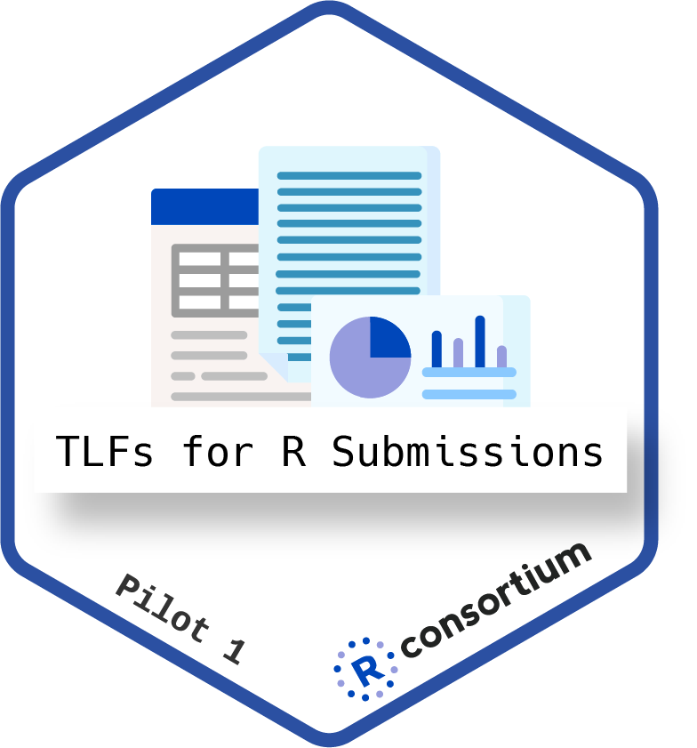
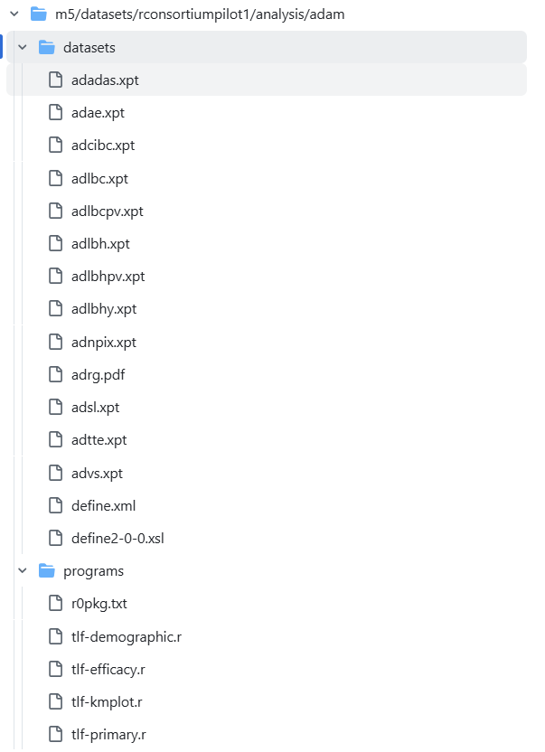




Pilot 1
2021–2022 | First R Consortium submission to FDA via eCTD
Goal
Example R based submission contains common analyses, submission through the current FDA e-submission system and process
Submitter
FDA
4 TLFs in R (CDISC pilot data)
{pkglite}: proprietary package → .txt
{renv}: reproducible environment
ADRG with detailed R execution guidance
e-Sub package
Confirmed that 4 static outputs from R could be successfully reviewed.
Key Insight
Proved the concept: R-based submission packages can successfully pass through the eCTD portal and be reviewed by FDA.
Sources: R Consortium [1][2][3]

Slide 8
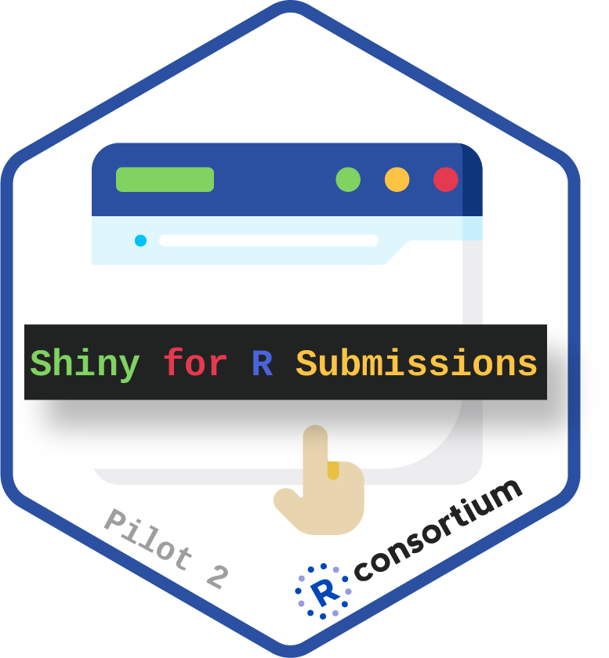
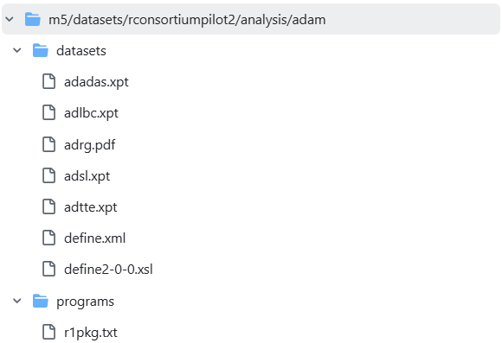
Pilot 2
2022–2024 | Interactive Shiny app submitted via eCTD
Goal
Example R based submission contains a shiny app, submission through the current FDA e-submission system and process
Submitter
FDA
{golem} to develop Shiny APP
{pkglite}: proprietary package → .txt
{renv} for reproducibility
Detailed Shiny execution guidance in ADRG
e-Sub package
Provided valuable feedback on Shiny apps:
a. Shiny should be supplementary, not replace TLF
b. Useful for visualization; potential for p-hacking
c. Recommend adding warning messages in ADRG
d. Explore alternatives for easier R package submission
Key Insight
FDA wants interactivity — but on their terms. "Supplementary, not replacement"
Sources: R Consortium [4][5][6]

Slide 9
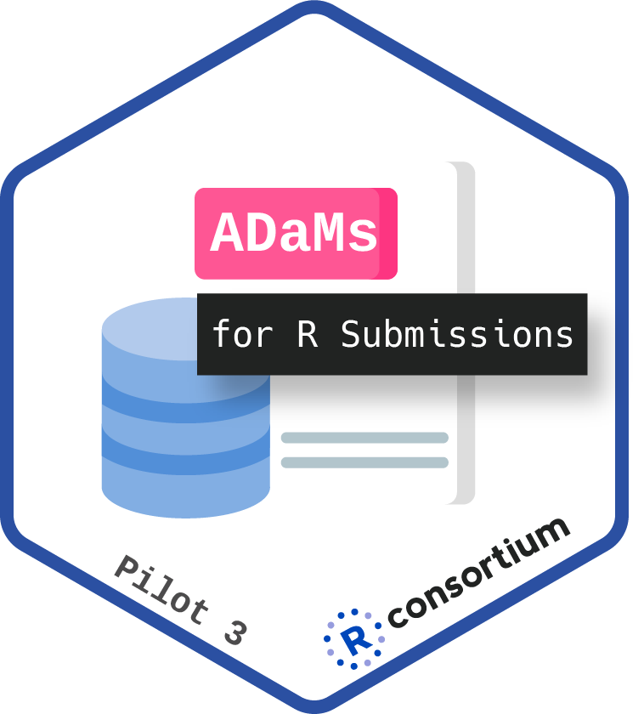
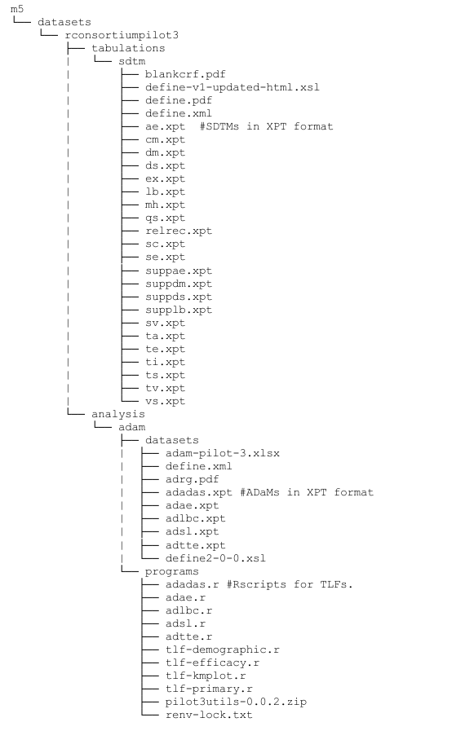
Pilot 3
2023–2024 | ADaM datasets AND TLFs all generated in R
Goal
Expand on the work done in Submission Pilot 1, by now utilizing R to generate ADaM datasets
Submitter
FDA
Proprietary packages as .zip (replacing {pkglite})
{renv} for reproducibility
Full ADaM+TLF pipeline in R
Detailed R execution steps in ADRG
e-Sub package
a. Use full file paths instead of relative;
b. Use accurate package names
Key Insight
Full R pipeline from ADaM creation to TLF output is reviewable
Sources: R Consortium [7][8][9]

Slide 10
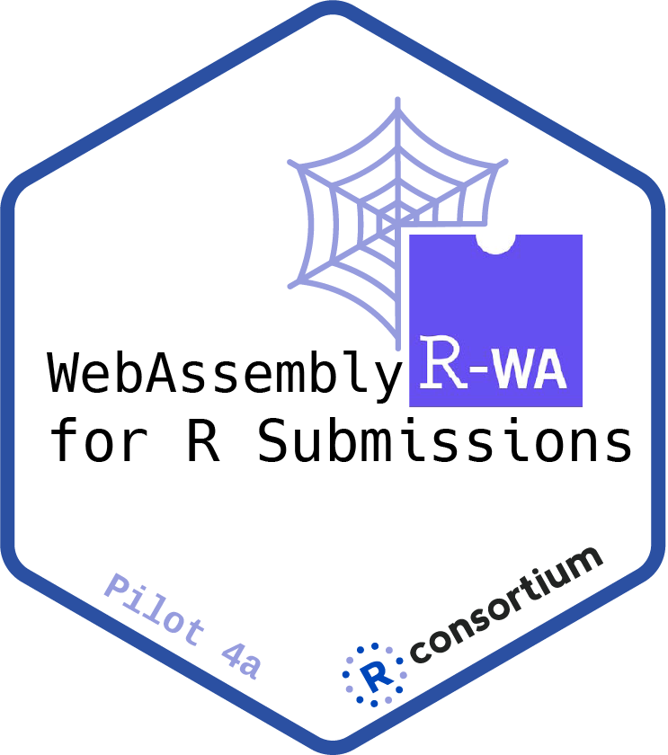
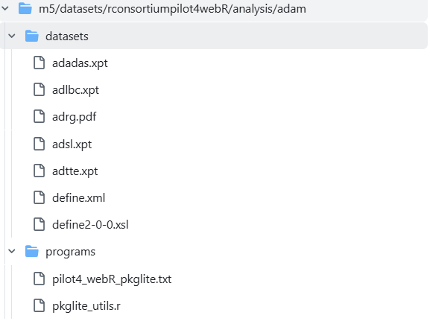
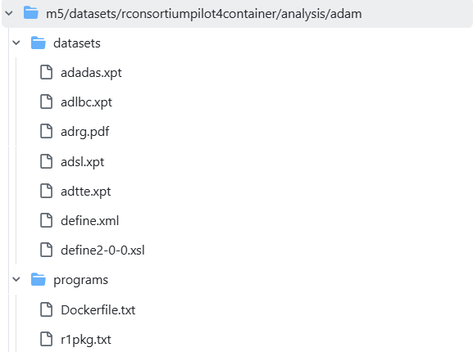
Pilot 4
2024 (nearing completion) | WebAssembly(Zero-install) + Container(Full environment reproducibility) for Shiny
Goal
Utilize alternative methods of distributing a self-contained submission bundle of the Pilot 2 Shiny application with web-assembly and Container technologies
Submitter
FDA
Pilot 4a: {rhino} for Shiny APP + {pkglite} + WebAssembly via {httpuv}
Pilot 4b: {golem} for Shiny APP + {pkglite} + Dockerfile.txt for container setup
Detailed Shiny execution guidance in ADRG
e-Sub package
a. Initially found WebAssembly easier than containers
b. FDA prefers install packages themselves
c. Clear preference for CRAN-hosted packages
Key Insight
Use CRAN open-source packages whenever possible
Sources: R Consortium [10][11][12][13][14]

Slide 11
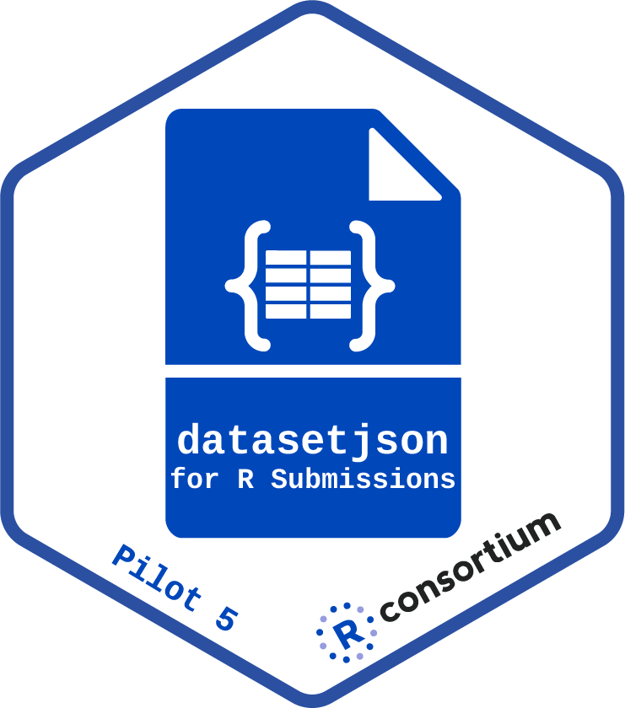
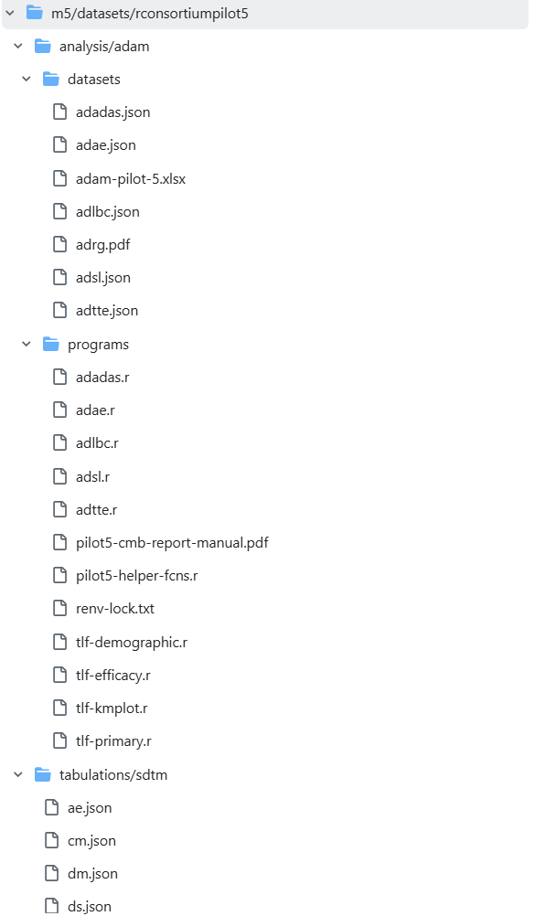
Pilot 5
2025 (nearing completion) | Dataset-JSON replacing .xpt via eCTD
Goal
Deliver a publicly accessible R-based Submission through the eCTD portal using datasetjson
Submitter
FDA
ADaM & SDTM in .json format
R scripts in .r format
{renv} for reproducibility
e-Sub package
Requested some minor rework with how intermediate datasets used in the programs, which led to a re-submission in early January 2026.
Key Insight
Data format (.xpt→JSON) + code delivery (.txt→.R) = both modernizing simultaneously.
Sources: R Consortium [15]

Slide 12
Part II: Practice Industry Momentum · J&J Deep Dive · What’s Next & Takeaway
Wenlan Pan

Slide 13
Industry Momentum
Who’s Moving to R for Regulatory Submissions?
From big pharma to biotech, multiple pathways – R is being used for critical, late-stage submissions.
Strategy
Packages
HA Interaction
Result
2021 · FIRST MOVER
Novo Nordisk
R for SDTM/ADaM/TLFs + SAS for Statistical Analysis
Initially internal packages; transitioning to GitHub & Pharmaverse
FDA Type C Meeting Package: use R – clarity plan & specify in ADRG, submit internal pkgs if not publicly FDA Pre-BLA Meeting Package: intended to use {pkglite}
FDA accepted
(2 IRs on reproducibility)
FDA: 1) Briefing pkg: accept + require validation
2) After Submission: tech walkthrough meeting
EMA: Raw Data Pilot Meeting: similar FDA tech walkthrough
NMPA: 1) Consultation window: Open-ended response
2) Type III meeting: more supportive information
3) Written response: consistent with FDA
2024 · END-TO-END
Roche
Full E2E R (SDTM → ADaM → TLFs)
Pharmaverse packages: e.g. oak/mint, admiral/admiralonco, tern/Chevron/tldg catalog; Proprietary: admiralroche
Oncology NDA approved by FDA with zero tech-related IR EMA & NMPA accepted
2024 · HYBRID
Johnson & Johnson
SAS for ADaM +
R for TLFs
All open-source packages: envsetup, tidyTLG, dplyr, tidyr, ggplot2, survival, epiR
Briefing book: Mock eCTD requested & accepted
FDA feedback to mock eSUB: update ADRG, request informal FDA meeting
2 FDA applications:
1 approved on schedule + 1 ongoing (positive response)
Also: Astellas (E2E Pilot, 2024) · Denali (BLA, R Dataset & TLFs in-house, 2025) · Novartis (2025) · and more...
Shared Key Lessons
Communicate early – Engage HAs before submission to align on R strategy
Go open-source – Build reviewer trust through code transparency
Validate in GxP — Risk-based approach for package qualification
Invest in ADRG – Your documentation is the reviewer’s guide to reproduce results
Sources: Novo Nordisk [18][19]; Roche [21][22][23]; J&J [26][27][28][29]; Astellas [32]; Denali [33]; Novartis [34]

Slide 14



J&J Deep Dive – Our Journey
From First Shiny Day to FDA-Approved R Submission (2018-2025)
2018
2019
2021
2022
2023
2024
2025
First
“Shiny Day”
Exploration &
Experiment
Flagship SAIL.R Initiative
First Open-source
Package
Submission
Focus
Hybrid R/SAS
FDA Submissions
R became “business as usual”
SAIL.R Initiative
Our Open-Source Toolbox
Why Open-Source Matters
Reporting Framework and Standards
Submission
Interactive Visualization and Reports
Change Management
{envsetup} — I/O path management via config file
{tidytlg} — Table, figure and listing creation using the ‘tidyverse’
Reproducible — No proprietary dependencies = no delivery headaches
Transparent — Reviewer verifies any function directly on CRAN
Sustainable – Community-tested, improved & maintained long-term
Sources: J&J [25][26][27][28][29]

Slide 15

J&J Deep Dive – From Mock to FDA Approval
A Pragmatic Approach: SAS for Datasets, R for Outputs
Our Hybrid Strategy
ADaM (SAS)
TLFs (R)
FDA / NMPA / PMDA / EMA
Keep current standards/knowledges reusable​
More flexible + Extensive visualization + Cutting-edge statistical modes
Take advantage of the strengths offered by various programming languages
FDA Interaction Milestones
Submission 1
Submission 2
Briefing Book
Mock eCTD requested & accepted
Briefing Book
Mock eCTD requested & accepted
Mock eCTD Submitted
Dummy ADaM in xpt + 5 R scripts + ADRG: new JNJ template based on the ADRG from R Consortium pilot 3 project
No mock submission
FDA Feedback
Send response & updated ADRG​
Request informal FDA meeting
Real Submission
R TLFs scripts in txt
Real Submission
R TLFs scripts in txt
FDA IR to ADaM
Zero R-related IRs
FDA IR for additional exploratory
Zero R-related IRs
FDA Approval
Positive feedback from HA

Slide 16
J&J Deep Dive – China-Specific Experience
SAS/R Hybrid Accepted
Regulatory Communication Insights
NMPA-Specific Adaptations
SAS/R Hybrid Code Submission
基于当前的监管沟通实践，CDE 对 SAS/R 混合模式的程序代码持开放接收态度, 建议按照《药物临床试验数据递交指导原则（试行）》对代码进行整理和递交。
Chinese ADRG
Full Chinese translation required
Detailed, transparent, and clear R execution guidance on ADRG
Mock Submission Feasibility
Folder Structure
根据现行技术审评环境，模拟申报尚未列入标准受理流程，建议企业关注后续政策动态。
Different from FDA eCTD mapping,
e.g. replace ‘misc’ folder with ‘dataset’ folder
R-Related Review Experience
Recommendation
Based on our submission experience, no R-specific technical queries were raised yet.
Provide code to support conversion of XPT V8 & V5
Note: 以上内容基于项目实践经验分享，不代表监管机构官方立场，具体执行请以官方最新发布指南为准。

Slide 17
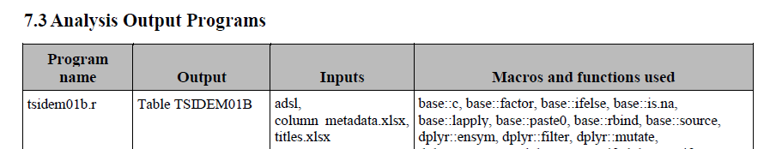
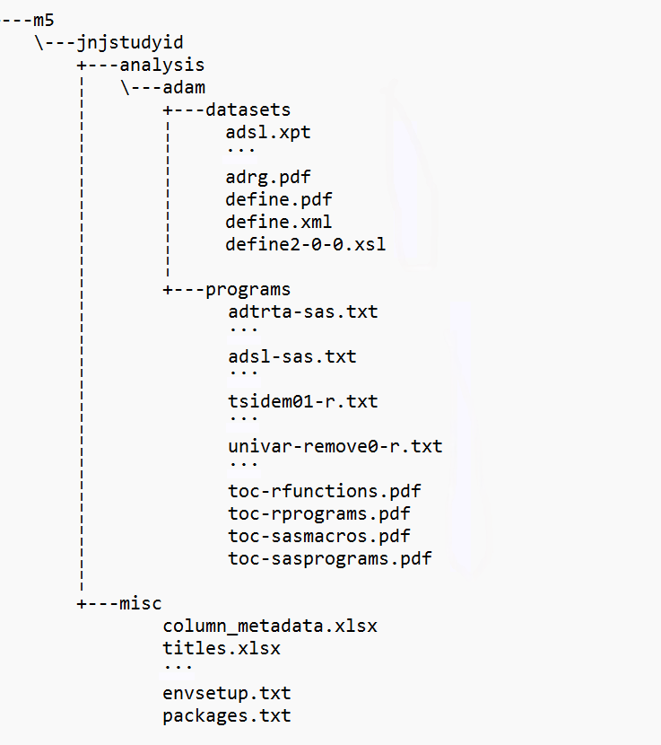
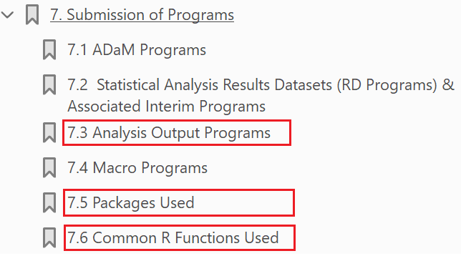
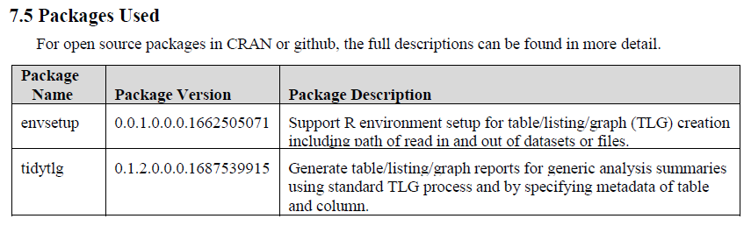
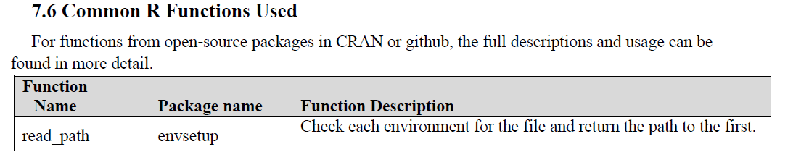
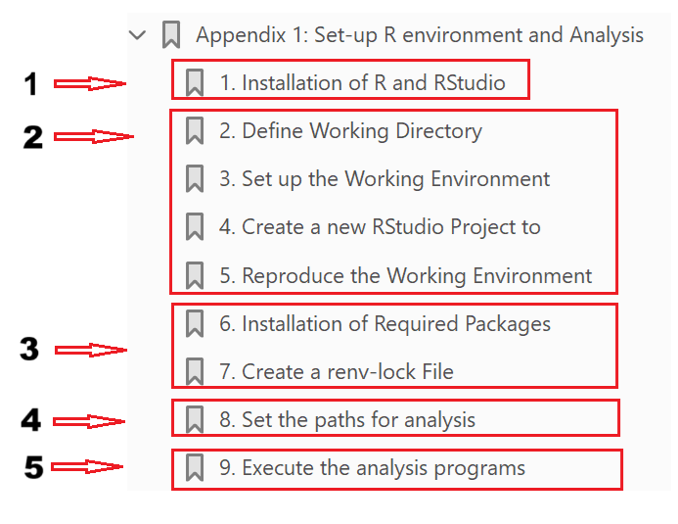
J&J Deep Dive – What’s Inside Our eCTD
Here’s Exactly What We Submitted
eCTD Package Structure
ADRG Key Sections
Section 7
ADaM in xpt
SAS macros in txt
SAS programs in txt
R programs in txt
R functions in txt
Appendix
Configuration files used for R setup in ADRG appendix

Slide 18
Recipe for Minimizing R-Related IRs
Three Pillars You Can Replicate for Your R Submission
2. Bulletproof ADRG
Based on R Consortium Pilot 3 template
Section 7: R packages & functions. Appendix: full windows setup guide
3. Mock Submission
1. 100% Open-Source Packages
Mock eCTD to FDA gateway before real submission
Got feedback, iterated ADRG, eliminated surprise
{envsetup}, {tidytlg} on CRAN/pharmaverse
No proprietary dependencies
Reviewer can inspect any source code of the packages

Slide 19
What’s Next
Interactive Review
Shiny apps: supplementary review tools WebAssembly: browser-based, no installation needed
Dataset-JSON: beyond .xpt
Container: full reproducibility
Modern Data Delivery
Intelligent Coding: GenAI for code generation, QC, documentation …
LLM-based assistants: efficiency leap
AI-Assisted Workflows
Sources: R Consortium Pilots [1]-[17]; Roche [37]

Slide 20
Key Takeaways
1
🏆 R is production-ready with proven flexibility.
Multiple HA approvals across big pharma & biotech. FDA's Aug 2025 guidance expands file format for R package delivery.
2
⚡ Regulatory alignment is the key to success.
Communicate with HAs early. Build confidence before the real submission.
3
📋 Documentation is your bridge to reviewers.
Invest in ADRG quality. The reviewer's ability to reproduce is your responsibility.
4
🤝 Collaboration and innovation accelerate the future.
R Community: Pharmaverse, R Consortium, R Validation Hub… New Tech: Shiny, Container, Dataset-JSON, AI…
The question is no longer IF, but HOW. Start your journey NOW.

Slide 21
Reference
R Consortium
[1] R Submission Pilot 1 – R Submissions Working Group
[2] GitHub - RConsortium/submissions-pilot1: development repo for pilot1 submission to FDA
[3] GitHub - RConsortium/submissions-pilot1-to-fda: eCTD package for pilot1 submission to FDA
[4] R Submission Pilot 2 – R Submissions Working Group
[5] GitHub - RConsortium/submissions-pilot2-to-fda: eCTD package for pilot 2 submission
[6] submissions-wg/_Documents/Summary_R_Pilot2_Submission 27SEP2023.pdf at 0f1dc5c30985d413f75d196c2b6caa96231b26ee · RConsortium/submissions-wg · GitHub
[7] R Submission Pilot 3 – R Submissions Working Group
[8] GitHub - RConsortium/submissions-pilot3-adam-to-fda: eCTD package for pilot3 submission to FDA - extension
[9] R Consortium - News from R Submissions Working Group – Pilot 3 Successfully Reviewed by FDA
[10] R Submission Pilot 4 – R Submissions Working Group
[11] GitHub - Appsilon/experimental-fda-submission-4-podman
[12] GitHub - RConsortium/submissions-pilot4-webR: Development repository for Pilot 4 WebAssembly Shiny App
[13] Pilot 4 Learning Session Notes: Container Technology – Submissions WG Pilot 4
[14] GitHub - RConsortium/submissions-pilot4-container-to-fda · GitHub
[15] submissions-pilot5-datasetjson-to-fda/m5/datasets/rconsortiumpilot5/analysis/adam at main · RConsortium/submissions-pilot5-datasetjson-to-fda · GitHub
[16] R Consortium - R Submissions Working Group: 2026 Plans and 2025 Success
[17] R in FDA Submissions: Lessons Learned from 5 FDA Pilots

Slide 22
Reference
Novo Nordisk
[18] YouTube: Novo Nordisk's Journey to an R based FDA Submission (Posit Webinar, Sep 2023)
[19] Appsilon: Learnings from the First R-Based Submission to FDA by Novo Nordisk (Jan 2024)
[20] PSI: Completing a Submission and Beyond in R (Ari Siggaard Knoph, Apr 2024)
Roche
[21] YouTube: Roche's End-to-End R Journey to Submission (Posit Webinar, Sep 2024)
[22] YouTube: Ning Leng - Roche's first end-to-end R submission (R in Pharma, Nov 2024)
[23] PHUSE 2025 Orlando: E2E R Submission from Roche Oncology Study
[24] YouTube: Joe Zhu - From Harmony to Hybrid: Charting a Practical Course for R Adoption in Pharma (R in Pharma, Dec 2025)
Johnson & Johnson
[25] PHUSE 2024 Strasbourg: SAIL.R – Journey Towards R Software in Johnson & Johnson. A Training Perspective
[26] YouTube: J&J: A Hybrid SAS/R Submission Story (RConsortium, Nov 2025)
[27] PHUSE SDE 2025: Johnson & Johnson’s Hybrid R Submission Strategy: Successful story of the R submission to the FDA
[28] Appsilon: Johnson & Johnson’s 5-Year Shift to R-Based Regulatory Submissions (Mar 2025)
[29] Posit: Johnson & Johnson’s Open Source Journey in R (Apr 2025)
[30] PharmaRUG 2025: How can we ensure that health authorities reproduce the sponsor's R based submission results?
[31] YouTube: R packages validation process in Johnson & Johnson: Using R in a GxP environment (Part 2)
Other Companies
[32] PHUSE EU 2025: Astellas End to End R: Where to Start?
[33] PHUSE EU 2025: Denali From Outsourced to Open Source: Denali's R-Driven Transformation in Biometrics
[34] Implementing R for Regulatory Submissions: Workflow, Guidance, and Best Practices
General Resources
[35] PHUSE 2022 Belfast: R for Submission - Experiences from the R Consortium Working Group​
[36] PHUSE 2024 Bethesda: HoW - Your First Submission in R
[37] PHUSE 2025 Orlando: Integrating GenAI with Open-Source Toolkit for Clinical Insights Generation
[38] CAMIS - A PHUSE DVOST Working Group
[39] GitHub - philbowsher/Open-Source-in-New-Drug-Applications-NDAs-FDA: List of Open-Source in New Drug Applications NDAs FDA · GitHub
[40] Expanded FDA eCTD File Format Support for R Packages — A Milestone Achieved Through Industry–FDA Collaboration (R Consortium, Dec 2025)

Slide 23
Thank you
Q&A
If you have more questions, please contact:
He Liu & Wenlan Pan
hliu167@its.jnj.com
wpan16@its.jnj.com

